Slide 1

Challenge Christian - GoFast

Slide 2

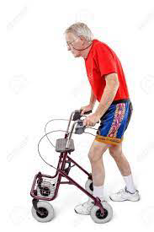
Challenge Christian
Context
Christian, 73 — energetic, curious, and loves to stay moving
Living with lasting effects of a mild stroke and an old car accident
Stiff arms and reduced coordination make walking feel less natural
Needs:
Asynchronous movement
Stability
Silence

Slide 3
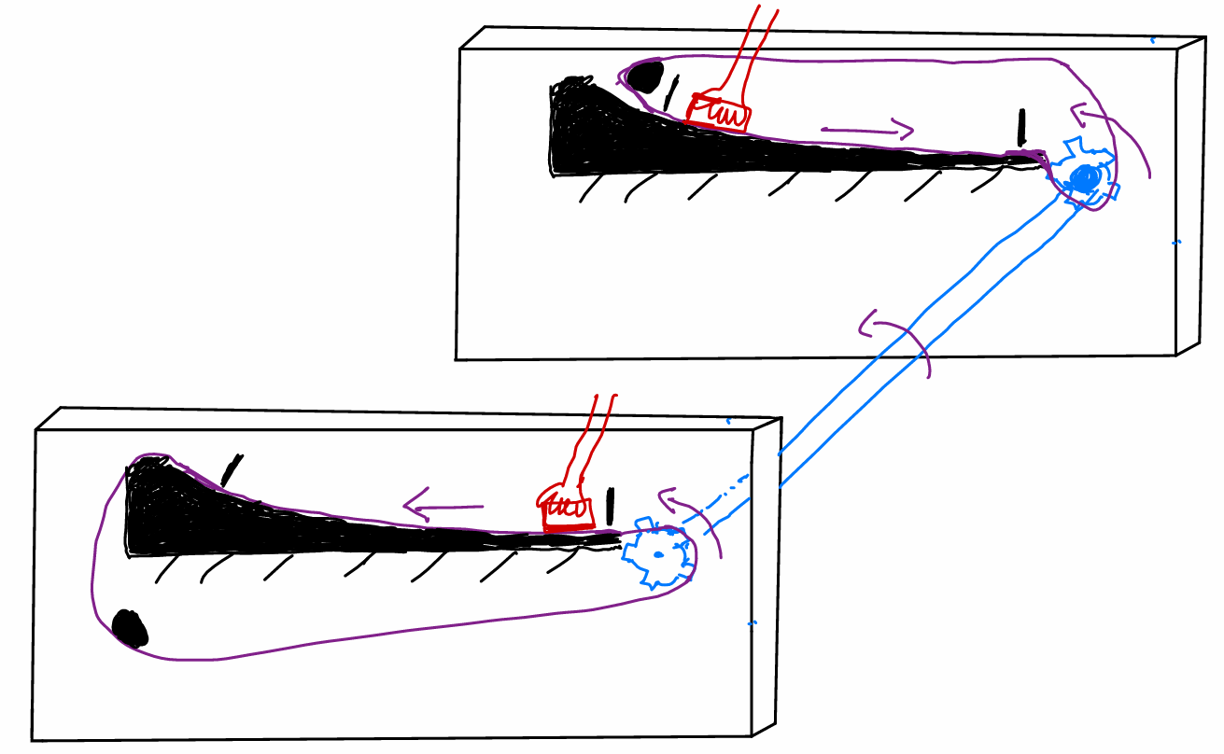
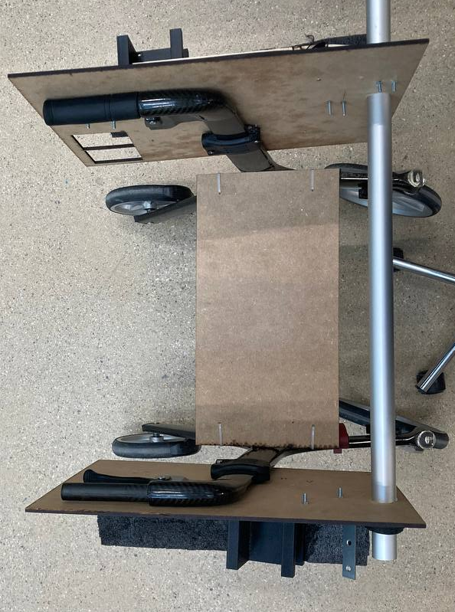
Natural Hand Movement Solution Christian

Slide 4
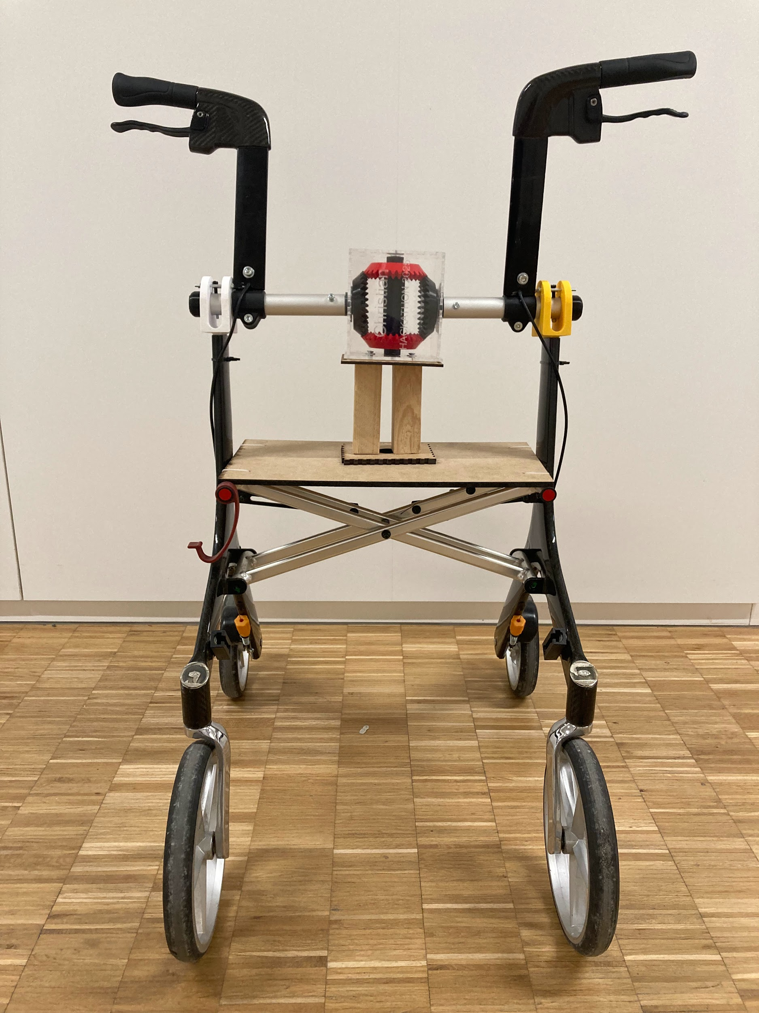
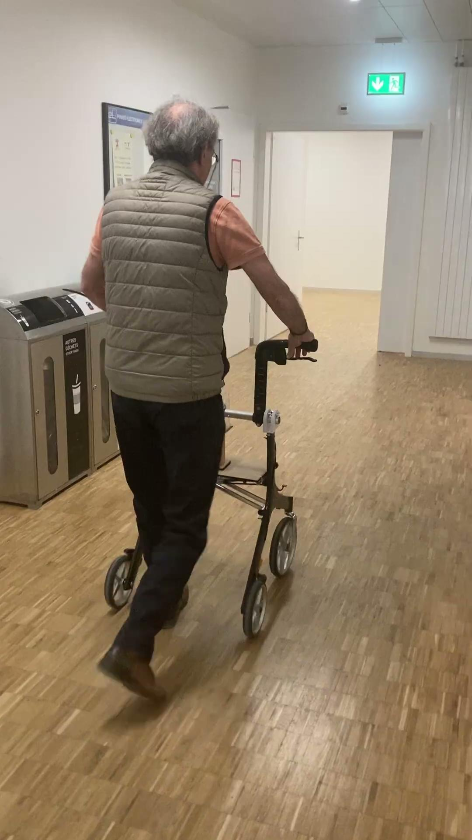
Solution Christian

Slide 5
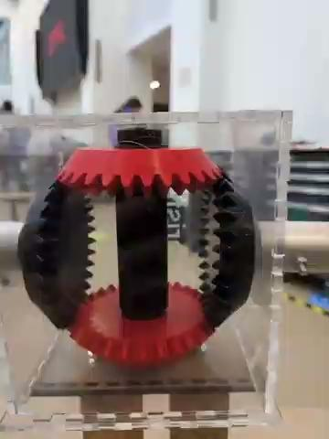
Solution Christian : Gofast
Asynchronous handle movement
Allow upper body movement with walking
Promote movement by helping to synchronize
Stability and safety
large handles
Brakes
Customizable Bupper/Stopper
(Almost) Silent mechanism

Slide 6
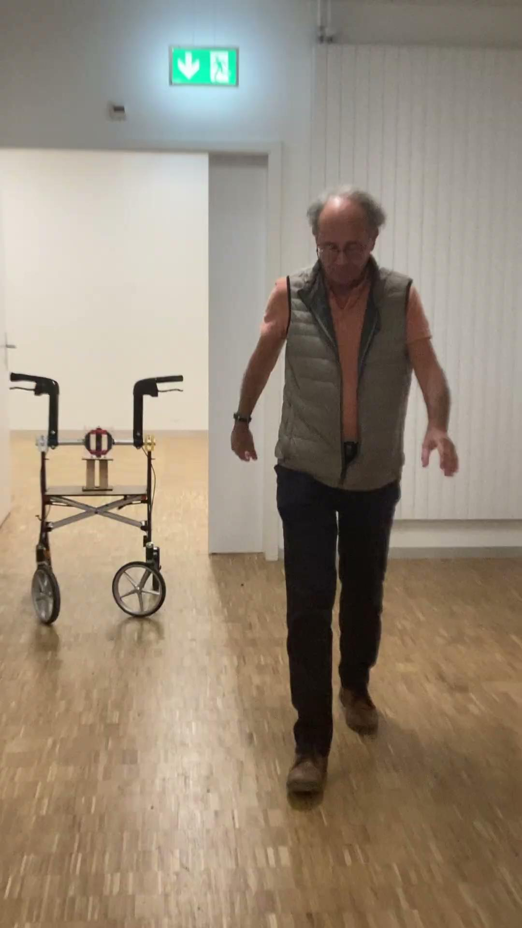
Demo Christian
Without Gofast
With Gofast

Slide 7
Perspective Christian
Next Steps
Continue developing the project together as a team
Publish the design and documentation on GitHub Elevate the gear system for smoother, more natural motion
Lower and redesign handles for better ergonomics
Improve overall design aesthetics and mechanical stability
Refine motion synchronization and structural balance
Address braking system performance and control
Current Limitations
3D-printed parts show tolerance deviations and fitting issues Minor mechanical instability under dynamic load
Brake system requires reinforcement and adjustment

Slide 8
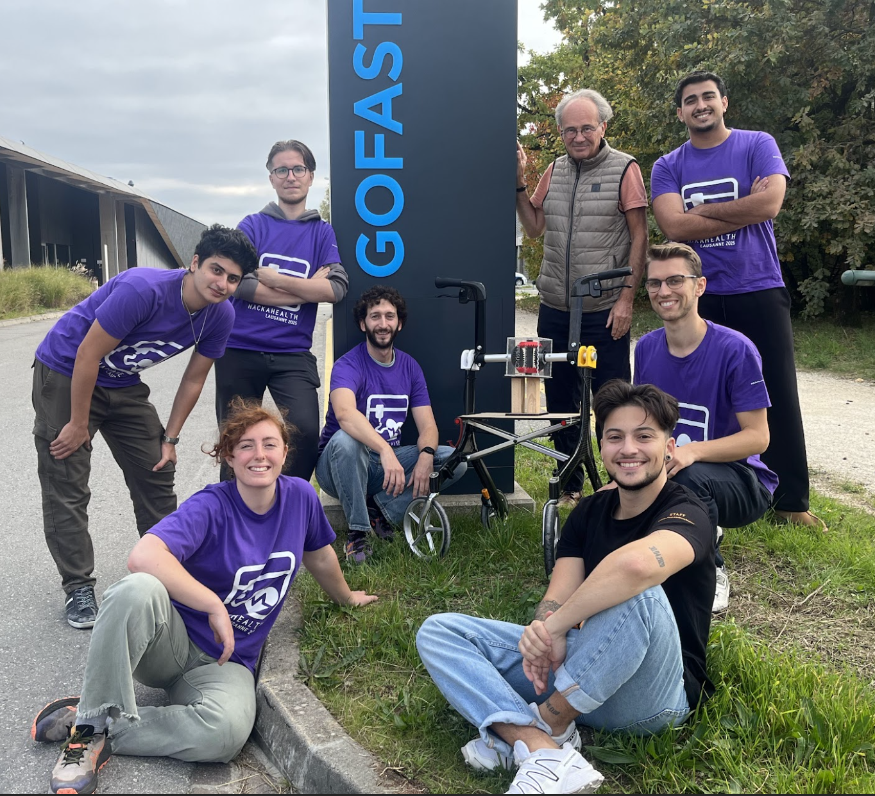
Team Christian

